Slide 1
Rinstrum Verification Officers Refresher Training 2022
X00A-837-201

Slide 2
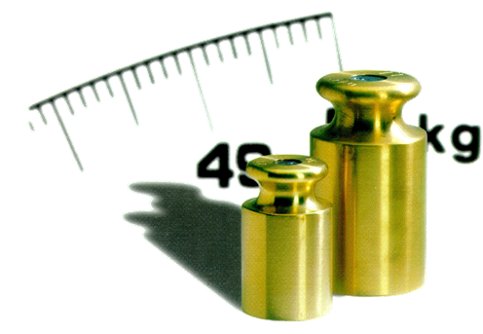
Content – RVO Refresher Training 2022
1. Introduction
1.1 Guidelines and Standards
1.2 EU Directives
1.3 Prerequisites
1.4 Rinstrum Manufacture Conformity Assessment Procedure
1.5 Rinstrum MCA Team
2. MCA Procedures and Instructions
3.1 RVO MCA Procedure
3.2 Check List for the Execution of MCA (X00A-808)
3.3 Comp Calc X00A-805
3.4 Verification Tests X00A-804
3.5 Seals and Labels
3.6 Documents to Rinstrum
3.7 Declaration
3.8 Clarification and Rejection
3. Rinstrum Verification Officers
3.1 RVO Support section in Rinstrum website
3.2 Common mistakes
4. Rinstrum Updates
3.1 UKCA Approvals
3.2 Rinstrum Onboard Weighing
5. Conclusion

Slide 3
Introduction
1.1 Guidelines and Standards
EU-Regulation
EU- and international Norm
2014/31/EU (NAWI)
2014/32/EU (MID)
EN45501
OIML R60 & R76
WELMEC
Worldwide harmonization of legal metrology
OIML recommendations
OIML documents
OIML Certificate System
Western European Legal Metrology Cooperation
WELMEC guides: harmonization of interpretations
Corresponding tables
EU Regulations
EU Directives
Publication of normative documents and harmonized standards

Slide 4
Introduction
1.2 EU Directives
Terminilogy
scale = measuring instrument = weighing instrument = non-automatic weighing instrument (NAWI)
Definition mentioned in the 2014/31/EU:
Weighing instrument’ means a measuring instrument serving to determine the mass of a body by using the action of gravity on that body. A weighing instrument may also serve to determine other mass-related magnitudes, quantities, parameters or characteristics
‘Non-automatic weighing instrument’ or ‘instrument’ means a weighing instrument requiring the intervention of an operator during weighing;

Slide 5
Introduction
1.2 EU Directives
Terminilogy
Verfication
Checking if the instrument fullfils all the requirements.
Calibration
Determining how much the measured value differ from the expected value.
Adjustment
Making the error smallest as possible.
Conformity Assestment
Checking the instrument against the requirements in EU directives.

Slide 6
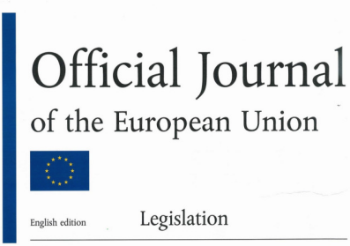
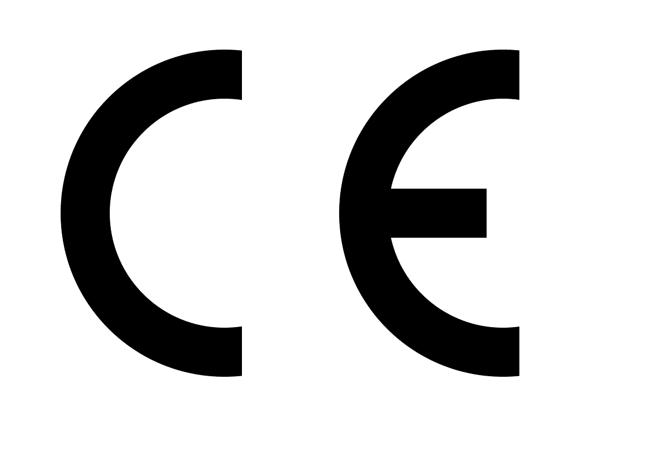
Introduction
1.2 EU Directive
Measuring instruments (MID)
2014/32/EU
Non-automatic weighing instruments (NAWI)
2014/31/EU
CE Marking
CE Marking can only be placed on an instrument if it complies with EU Directives.
M22 0122

Slide 7
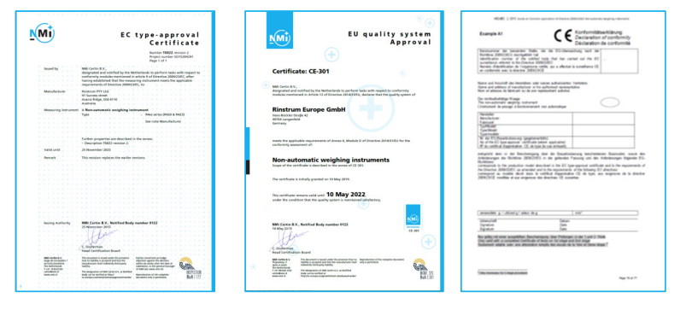
Introduction
1.2 EU Directive
• Instruments placed on the market must comply with the directives.
• Instruments put in use must have had a conformity assessment.
• At the time of putting into use a declaration of conformity must be available.

Slide 8
Introduction
1.2 EU Directive
By declaring the conformity of a scale with the essential requirements of the relevant EU regulations, especially 2014/31/EU, the newly placed scale is considered equal to a calibrated scale.
The processed is called
Manufacturer Conformity Assessment process
RINSTRUM is the manufacturer of the scale (indicator and bridge)
The MCA process is closed by RINSTRUM, not by the RVO on site
Therefore, the documents have to be sent to RINSTRUM.

Slide 9
Introduction
1.3 Prerequisites
Read and understand Rinstrum MCA Requirements and Policy (X00A-873)
Valid Commitment as Rinstrum Verification Officer (X00A-812)
Proof of liability insurance (company of the authorized person). Companies need to submit the liability insurance to Rinstrum.
Participation of authorized persons in internal trainings on the manufacturer's conformity assessment procedure
Successful passing of the online test
Well known and at hand: - All relevant EU-regulations (2014/31/EU) and national law - All relevant Norms EN 45501:2015, OIML and WELMEC

Slide 10
Introduction
1.3 Prerequisites
Rinstrum Documents Related to RVO
Work instruction - Initial Verification Procedure (X00A-803-170)
Work instruction - Verification Test (X00A-804-280)
Work instruction - Flowchart (X008-809-161)
Template - Verification of Compatibility (X00A-805-120)
Template - Test Report (X00A-822-269)
Template - Check List for the Execution of First Verification (X00A-808-180)
The templates used for all documents must be up-to-date, it is your responsibility. Updates will be notified via email.
Please log on to website and get the latest revisions.

Slide 11
Introduction
1.3 Prerequisites
Other Documents
Type Approval Certificate (TAC) for the used load cell OIML R60 certified
Calibration Certificate for the used weights (documenting the traceability to national standards)

Slide 12
Introduction
1.4 MCA Flow Chart (X00A-809)
Training Rinstrum Verification Officer RVO:
RVO will sign a Commitment (X00A-812, X00A-820)
Training Certificate (X00A-811, X00A-819)
Renew authorization once in every 2 year
Rinstrum Metrological Services Assistant:
Inform RVO on Issues
Raise a Case in M-files for the MCA.
No
Rinstrum Metrological Services:
Declaration of Conformity issued?
Yes
Rinstrum Verification Officer RVO:
MCA Procedure X00A-803
Sends files to verification@rinstrum.com
RVO:
Clear the Issue with MCA
Yes
Rinstrum Metrological Services Assistant:
Issue Declaration of Conformity
Notifies the MCA Accounting.
No
MCA Accounting:
Raise the sales order
Acknowledgement email
Rinstrum Metrological Services Assistant:
Update the Case in M-files for the MCA
Inform RVO.
Yes
MCA Accounting:
Is the Company ON Hold ?
No
MCA Accounting:
Is the company released ?
Rinstrum Metrological Services Assistant:
Store files with the S/N of the indicator in M-Files.
Conformity Check X00A-807
MCA procedure – Internal X00A-860
Warrants the issue of a Declaration of Conformity
MCA Accounting:
Reject the MCA
Raise a Case and inform RVO.
MCA Accounting:
Sends the issued Declaration of Conformity with the invoice
Yes
RVO:
The verification isn’t valid and all stickers, sealing stickers and labels must be removed.
RVO:
Sends or gives in person the Declaration of Conformity to the customer. If necessary, according to national law, he will advice the customer to inform the National Weights and Measures Office about the verified scale.

Slide 13
Introduction
1.5 Rinstrum MCA Team
Marek Swierzy
General Manager
Rinstrum Europe GmbH
Marek.Swierzy@rinstrum.com
Kalana Lalitharathne
General Manager
Rinstrum Pvt Ltd
Kalana.Lalitharathne@rinstrum.com
Metrological Service Manager
General Manager
Thahiru Herath
Engineering Manager
Rinstrum Pvt Ltd
Thahiru.Herath@rinstrum.com
Sarala Rathnayake
Product Development Engineer
Rinstrum Pvt Ltd
Sarala.Rathnayake@rinstrum.com
Metrological Service Assistant
Metrological Service Assistant
Kasun Rathnayake
Technical Assistant
Rinstrum Pvt Ltd
Kasun.Rathnayaka@rinstrum.com
Sachini Hithakshika
Sale and Administration Support
Rinstrum Pvt Ltd Sachini.Hithakshika@rinstrum.com
Metrological Service Assistant
MCA Accounting

Slide 14
MCA Procedures and Instructions
2.1 RVO MCA Procedure
 | WI
Check list |  | X00A-808
Visual inspection | X00A-803-170
Printer | The printout should be checked
Verification of Compatibility for Modules |  | X00A-805
Verification tests | X00A-804-280 | X00A-822
Sealing
Rinstrum Certification and Trade Label
Email

Slide 15
MCA Procedures and Instructions
2.2 Check List for the Execution of MCA (X00A-808)
Check list X00A-808

Slide 16
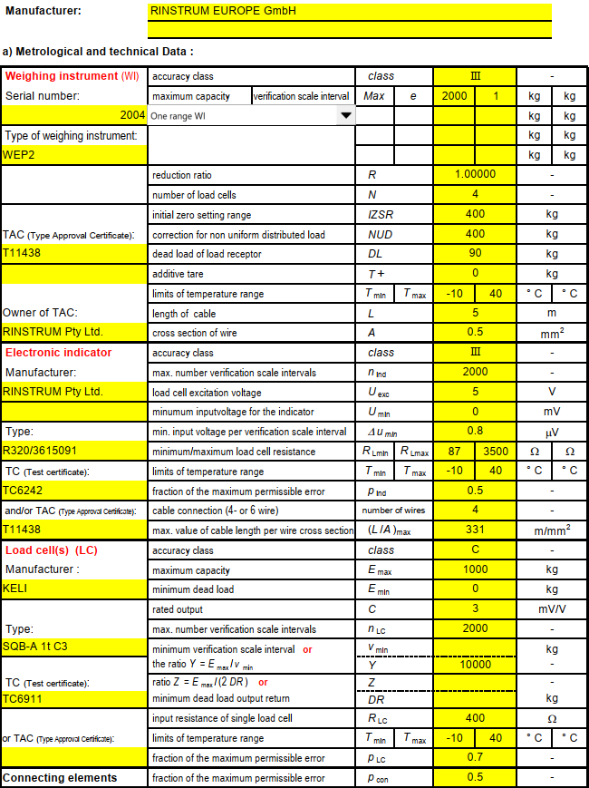
MCA Procedures and Instructions
2.3 Verification of Compatibility (X00A-805)
Ensure that the modules are compatible

Slide 17
MCA Procedures and Instructions
2.3 Verification of Compatibility

Slide 18
MCA Procedures and Instructions
2.3 Verification of Compatibility

Slide 19
MCA Procedures and Instructions
2.3 Verification of Compatibility

Slide 20
MCA Procedures and Instructions
2.3 Verification of Compatibility

Slide 21
MCA Procedures and Instructions
2.4 Verification Tests (X00A-804)
The tests should be conducted in accordance with DIN EN 45501-2015
The results shall be recorded in the Test Report X00A-822.
At the beginning of each test ensure that the scale is in its reference position (not tilted), i.e. the bubble is in the center of the marked circle.
The tests should be performed at a steady ambient temperature.
At the end of the tests for Test Report, HI_RES should be switched off before the calibration counter is recorded.

Slide 22
MCA Procedures and Instructions
2.4 Verification Tests
Visually inspect the scale – indicator , weighbridge
Damage or other problems which may make the scale unsuitable
Metrological characteristics, i.e. accuracy class, Min, Max, e, d
Ensure the settings in the indicator – according to OIML (USE: OIML, zero range and zero band not more than 4% Max)
Identification of firmware
Ensure the correct modules are used
Prescribed inscriptions and positions for verification and control marks
Ensure that the cable shield and earth are connected. If RS232-interface is used, please advise the manufacturer to install a module to avoid damage because of potential differences.
Check the construction of the weighbridge to be in accordance with EN45501:2015 and WELMEC 2.4

Slide 23
MCA Procedures and Instructions
2.4 Verification Tests
X00A-822 Select the appropriate sheet regarding to the tested scale. At the top of each sheet the language English or German can be chosen. All orange data fields must be completed.
Dual Range max. < 1t
Dual Range max. > 1t
Dual Range Truck Scale
Single Range max. < 10kg
Single Range max. < 1t Gravity
Single Range max. > 1t Gravity
Single Range Truck Gravity
Hanging scale < 1t
Single Range medical bed

Slide 24
MCA Procedures and Instructions
2.4 Verification Tests

Slide 25
MCA Procedures and Instructions
2.4 Verification Tests
Substitution of standard weights at verification (for Max.>1t)
When testing instruments at the place of use (application), instead of standard weights any other constant load may be used, provided that standard weights of at least 50% Max are used.
If it isn’t allowed to transport more than 20t of weights on the roads, like in Hungary, it is permitted to do Repeatability Test for a scale with Max up to 60t with a contingent of only 20t standard weights. Provided that the repeatability max.error is not more than 0,2e. Repeatability Test must then be performed at a total load of about 50% Max, made up of the standard weights + Truck + substitution material.
If the repeatability error is not more than 0,3e the portion of standard weights may be reduced to 35% Max
If the repeatability error is not more than 0,2e the portion of standard weights may be reduced to 20% Max
Procedure for using substitution material:
Put the contingent of standard weights onto the scale that you would like to substitute. Note down which weight the indicator shows. Then load substitution material onto the scale until the indicator shows exactly the same weight.
After that, gently add the standard weights up to the next test load. Same procedure would be downwards.

Slide 26
MCA Procedures and Instructions
2.4 Verification Tests
Tests
Repeatability Test
Accuracy of zero device
Accuracy of tare device
Weighing / Linearity Test
Tare (Weighing Test)*
Eccentricity Test
Test with coasting load (Truck Scales)
Tilting test ( for medical bed Class III only )

Slide 27
MCA Procedures and Instructions
2.4 Verification Tests
Test 1: Repeatability Test
The instrument’s automatic zero-setting and zero-tracking device may be in operation during this test.
Before testing repeatability the scale has to be pre-loaded with Max.
At least three weighings with about 80% Max are necessary.
It is allowed to zero the instrument between the weighings, if it doesn’t show zero.
Evaluation of Error is calculated in the sheet. The error between the three readings shouldn’t be more than the absolute value of the permissible error.

Slide 28
MCA Procedures and Instructions
2.4 Verification Tests
Actual sample load
Indication
Indication Error
Max Permissible Error

Slide 29
MCA Procedures and Instructions
2.4 Verification Tests
Test 2: Accuracy of zero device
High-Res Mode must be switched off.
A weight close to Zero must be loaded onto the scale.
Indicator must now be set to Zero by pressing the Zero-button
A weight close to Zero must be loaded onto the scale.
Note down the number of added weights.
Evaluation of Error is calculated in the sheet.

Slide 30
MCA Procedures and Instructions
2.4 Verification Tests

Slide 31
MCA Procedures and Instructions
2.4 Verification Tests
Test 3: Accuracy of tare device
High-Res Mode and Zero tracking must be switched off.
This test is to be performed in the same manner as Test 2.
A weight between 1/3 and 2/3 of Max must be loaded onto the scale.
Indicator must now be tared by pressing the Tare-button.
Standard weights of 1/10e must be gently added, until indication changes from one scale interval to the next above.
Note down the number of added weights.
Evaluation of Error is calculated in the sheet.

Slide 32
MCA Procedures and Instructions
2.4 Verification Tests

Slide 33
MCA Procedures and Instructions
2.4 Verification Tests
Test 4: Weighing / Linearity Test
Apply 5 test loads and similarly remove them back to zero.
The loads selected shall include Min and Max and values at or near to those at which the maximum permissible error (mpe) changes (500e and 2000e).
The scale should not be allowed to return to zero between loads.
If substitution material is used, you must first load from zero up to the maximum quantity of standard weights. Then remove the weights and substitute the previous weights with substitution material. Repeat the procedure until Max is reached. Unload in reverse order to zero.
The calculation sheets calculates the total error E_{error} - E_{zero.} If this total error is less or equal to 0,5e, Tare Test 5 has not to be performed.

Slide 34
MCA Procedures and Instructions
2.4 Verification Tests

Slide 35
MCA Procedures and Instructions
2.4 Verification Tests
Test 5: Tare (Weighing Test)
The Test Report sheet calculates if this Test has to be undertaken or not.
This test has to be performed if the total error in Test 4 is more than 0,5e.
A load between 1/3 and 2/3 Max should be applied and then be tared.
Apply 5 test loads and similarly remove them back to zero.
The loads selected shall include Max (maximum possible NET load) and Min and values at or near to those at which the maximum permissible error (mpe) changes (500e and 2000e).
The scale should not be allowed to return to zero between loads.
If substitution material is used, you must first load from zero up to the maximum quantity of standard weights. Then remove the weights and substitute the previous weights with substitution material. Repeat the procedure until Max is reached. Unload in reverse order to zero.

Slide 36
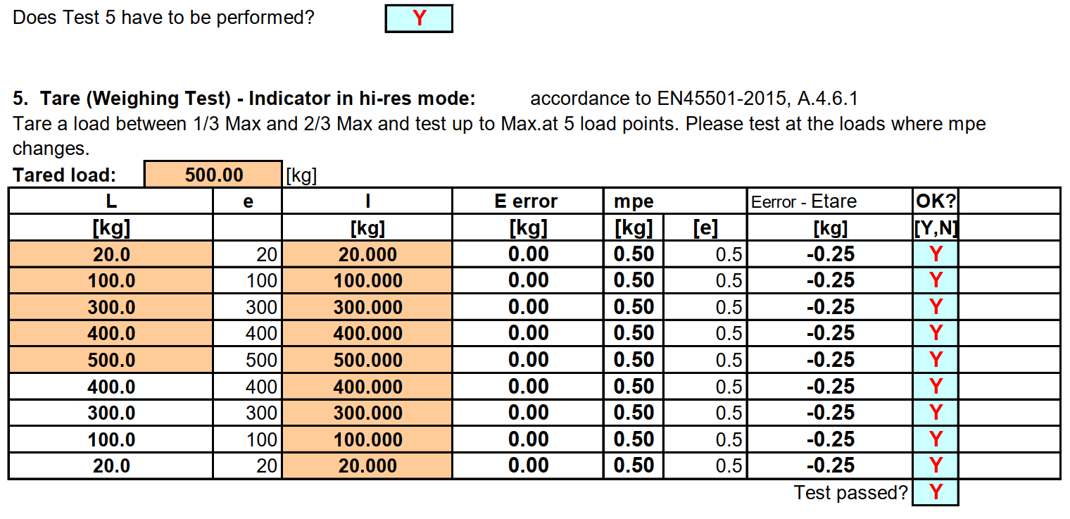
MCA Procedures and Instructions
2.4 Verification Tests

Slide 37
MCA Procedures and Instructions
2.4 Verification Tests
Test 6: Eccentricity Test
Zero-setting or zero-tracking device shall not be in operation.
Large weights should in preference to several small weights.
For an instrument with a load receptor having not more than four points of support, the four quarter segments roughly equal to ¼ of the surface of it shall be loaded in turn. The test load shall be 1/3 Max.
For an instrument with a load receptor having more than four points of support, the test load of (1/n-1) Max shall be applied over each support on an area of 1/n of the surface area of the load receptor.
Where two points of support are too close together for the test load, the doubled load shall be distributed over twice the area on both sides of the axis connecting the two points of support.
Eccentricity for Dual range scale should be tested at 1/3 of Max.

Slide 38
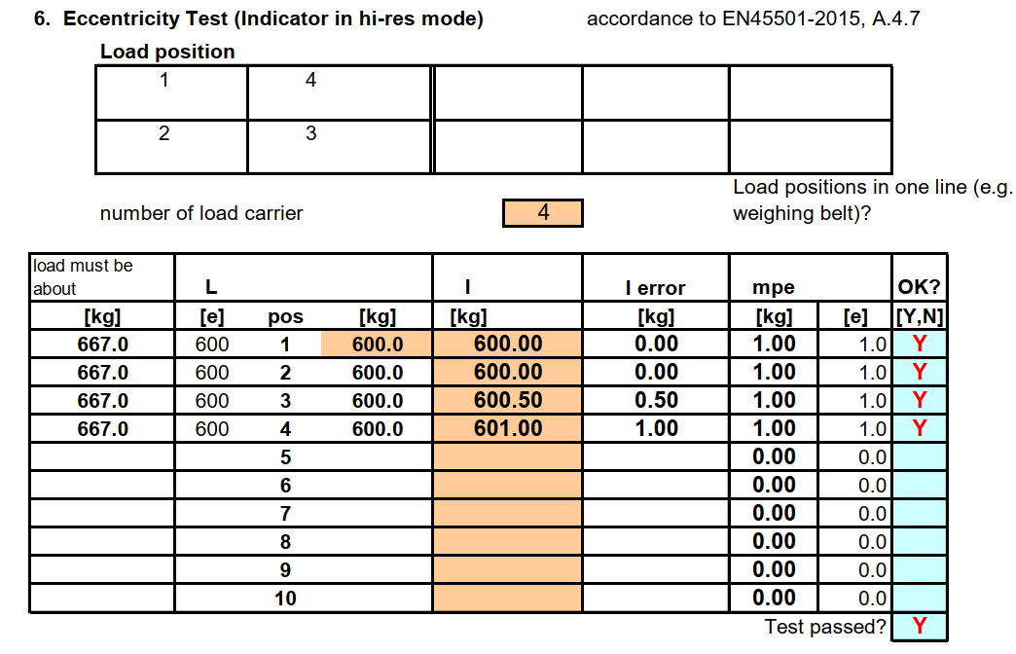
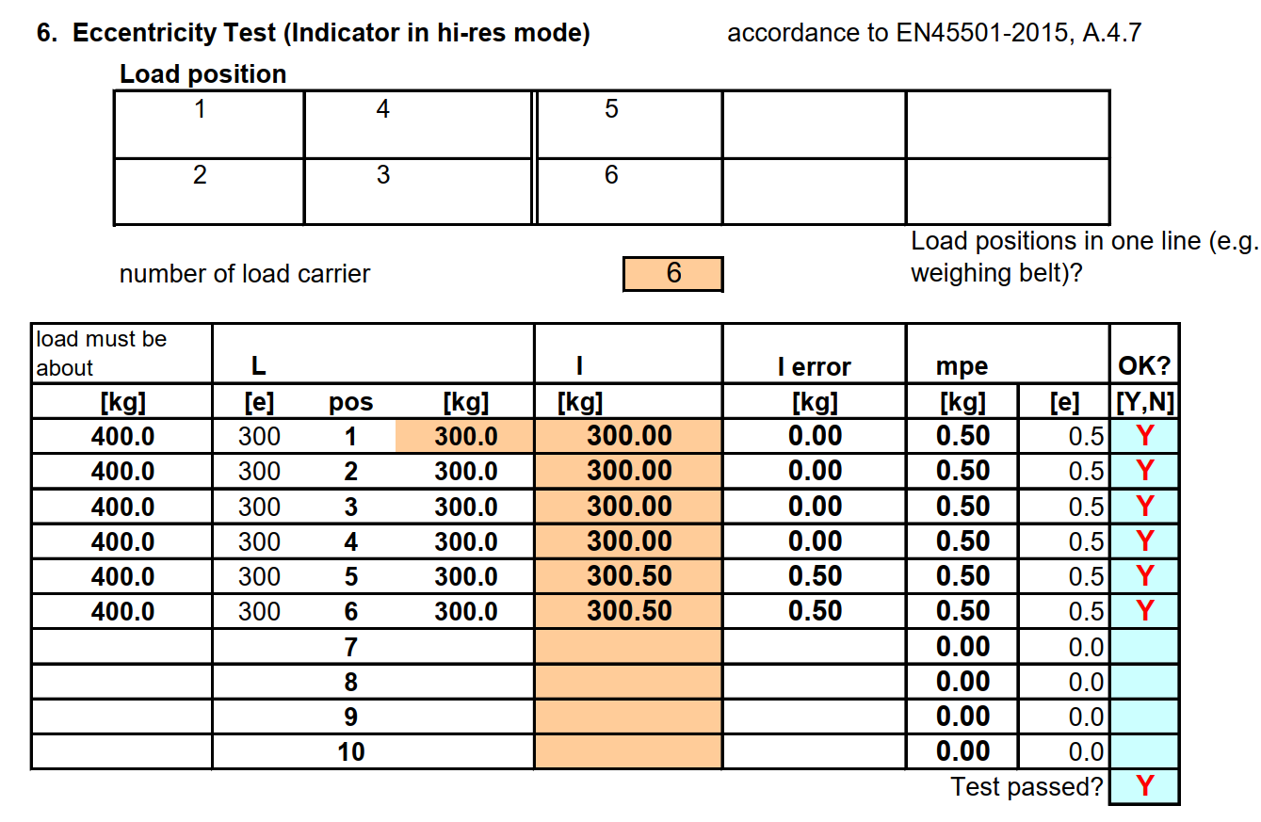
MCA Procedures and Instructions
2.4 Verification Tests

Slide 39
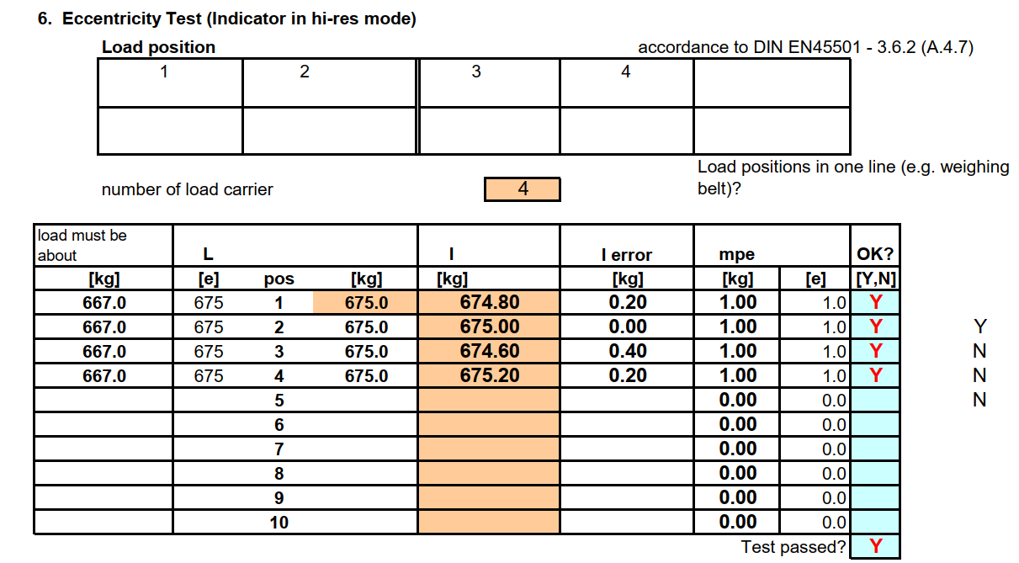
MCA Procedures and Instructions
2.4 Verification Tests

Slide 40
MCA Procedures and Instructions
2.4 Verification Tests
Test 7: Test with coasting load (Truck Scales)
A truck load of at least 50% Max but not exceeding 80% Max shall be driven onto the weighbridge from each of the access roads.
Measurements shall be carried out in each of the three bridge segments.
The distance from the middle position to the first or end position shall be more than 0,1B , where B is the length of the bridge.
Length an width of scale should be entered.

Slide 41
MCA Procedures and Instructions
2.4 Verification Tests

Slide 42
MCA Procedures and Instructions
2.4 Verification Tests
Test 8: Tilting test ( for medical bed Class III only )
The bed must be in reference position, without inclination, no load on it.
Indicator must now be set to Zero by pressing the Zero-button.
Max. load must be put onto the bed and the indicated weight must be written into the test report.
Then, the bed must be inclined until the bubble in the levelling device touches the marking in all four directions.
Now the indicated weight without any load and with Max load must be written to the test report in every inclined direction.
This test is not necessary for medical beds Class IIII

Slide 43
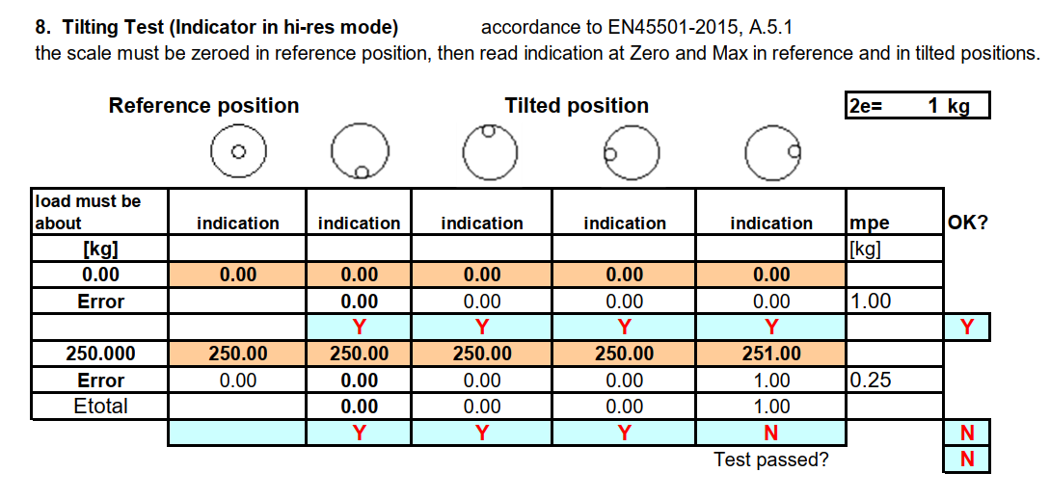
MCA Procedures and Instructions
3.4 Verification Tests

Slide 44
MCA Procedures and Instructions
2.4 Verification Tests
Earth Gravity
If necessary, verify the earth gravity for the place of use
Place of installation
Name and town of the installation
Calibration Counter
The high resolution mode (HI_RES) shall be switched off. Then calibration counter should be recorded.

Slide 45
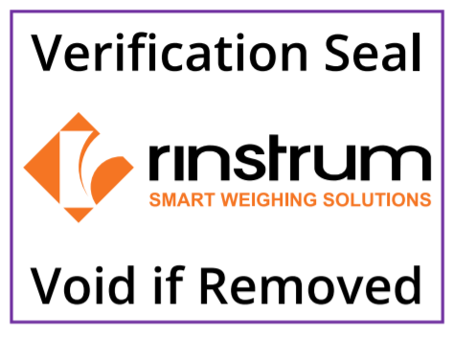
Manufacture Conformity Assessment
2.5 Seals and Labels
Trade Label RVO 2023
X00A-309-101 (A11030-23)
Certification Label
X00A-302-202 (A11047)
Certification Seal
X00A-305-101 (A11029)
Transparent Foil
X00A-306-100 (A11037)
Use this Stockcode LABEL-23-KIT for set of labels for 10 Scale.
50 x Certification Seals
10 x Trade Labels RVO 2023
10 x Certification Labels
20 x Transparent Foils

Slide 46
Manufacture Conformity Assessment
2.5 Seals and Labels
How to put label and seal on the indicator
Affix the verification labels. Ensure they are filled out correctly.
Use a UV rated permanent pen.
Stick the transparent foil over the verification labels for protection.
Seal all the affixed labels.

Slide 47
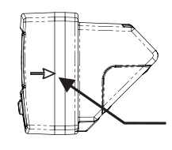
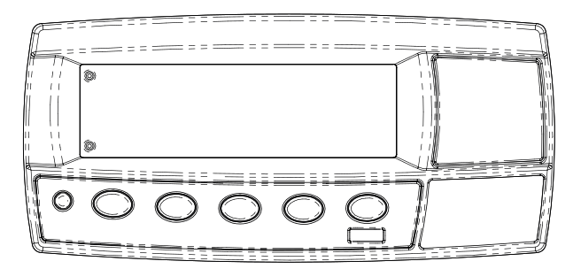
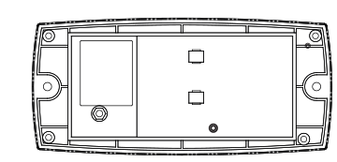
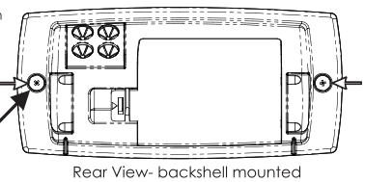
Manufacture Conformity Assessment
2.5 Seals and Labels
Sealing the R320 Indicator
Aflix Trade lable and certification Lable with void labels
Option 2
Void Lable
Void Lable
Option 3
Option 1
Void Lable
Void Lable
Void Lable
Void Lable

Slide 48
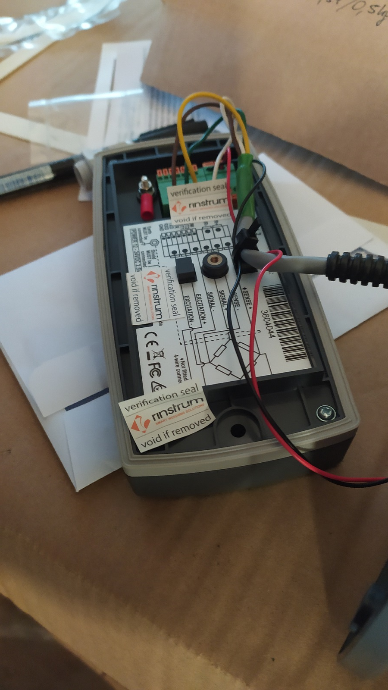
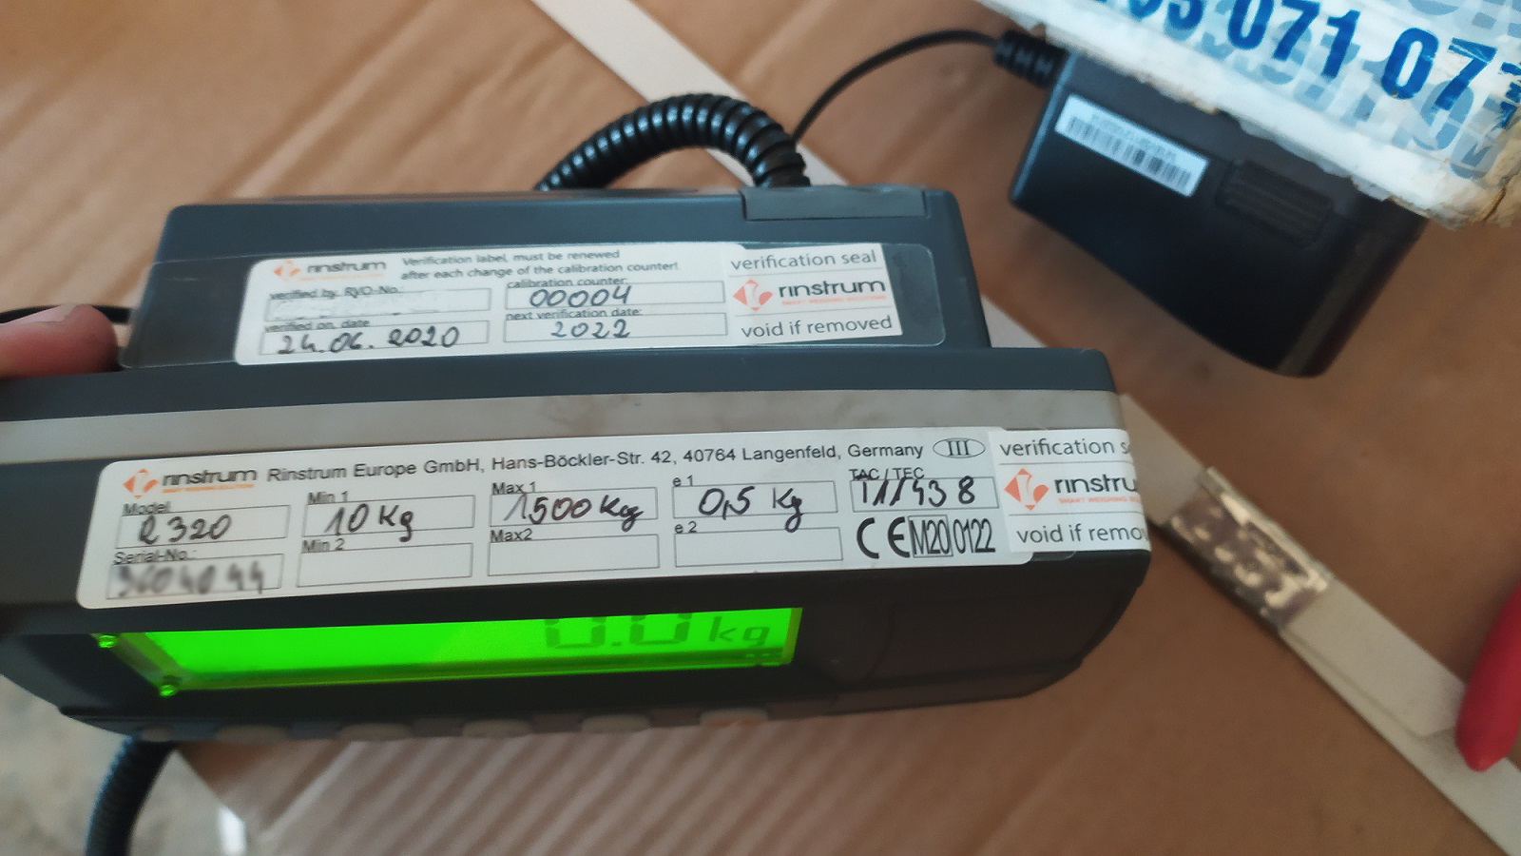
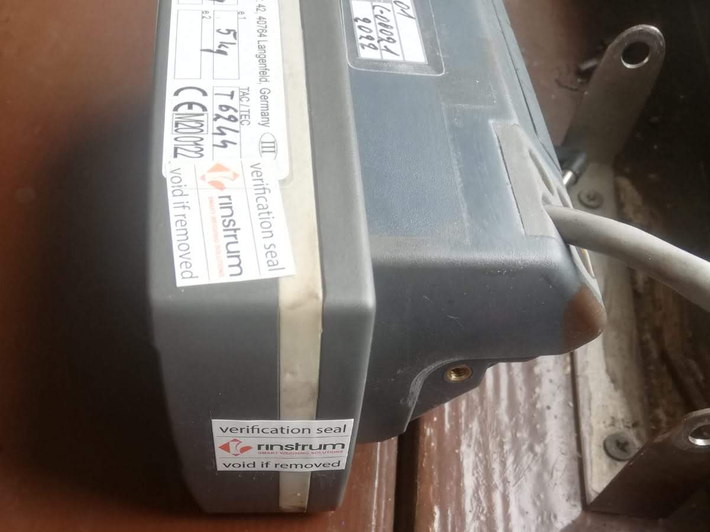
Manufacture Conformity Assessment
2.5 Seals and Labels

Slide 49
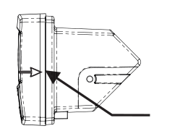
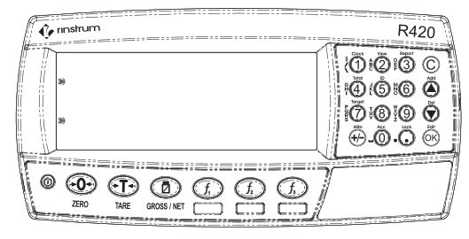
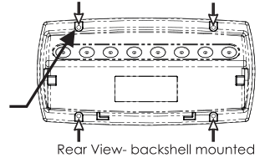
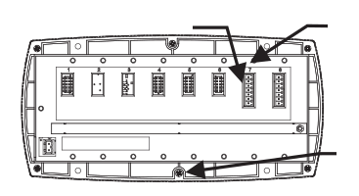
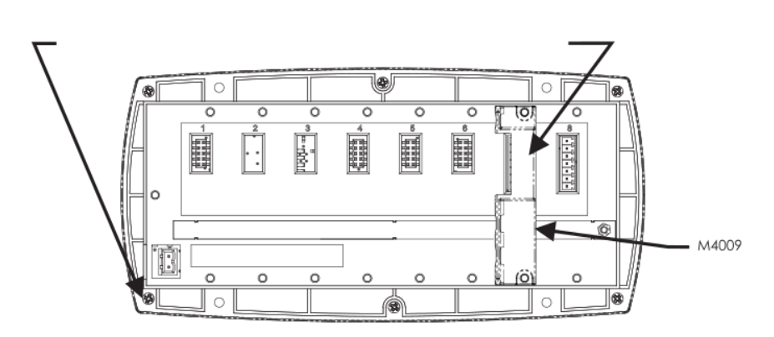
Manufacture Conformity Assessment
2.5 Seals and Labels
Sealing the R420 Indicator
Aflix Trade lable and certification Lable with void labels
Option 2
Void Lable
Option 3
Option 1
Void Lable
Void Lable
Void Lable
Void Lable
Void Lable
Option 4
Void Lable

Slide 50
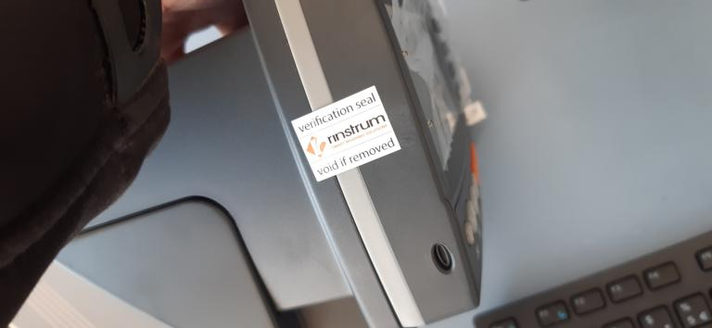
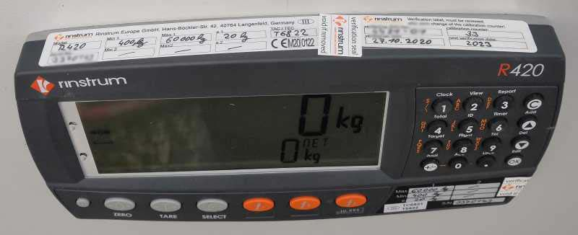
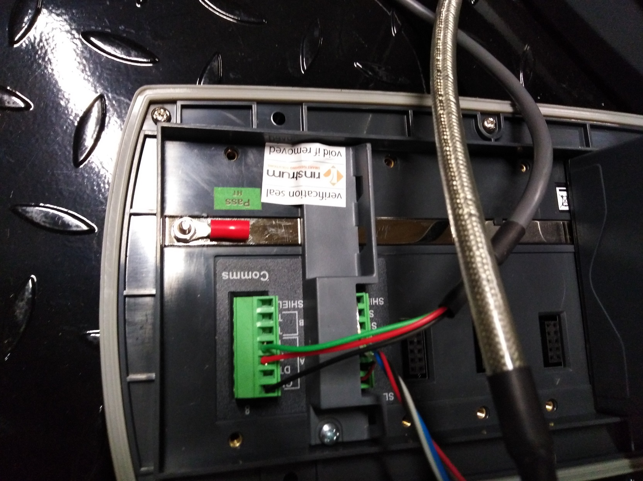
Manufacture Conformity Assessment
2.5 Seals and Labels

Slide 51
Manufacture Conformity Assessment
2.5 Seals and Labels
Sealing the Junction Box

Slide 52
2.6 Documents to Rinstrum
Document | Format
X00A-808 | Pdf or scanned Pdf\Image
X00A-805 | Excel or Pdf
X00A-822 | Excel or Pdf
Photos | Images
Certificate of used standard weights (Copy) | Pdf
Certificate of the used delta-weights (Copy) | Pdf
TC Loadcell (Copy) | Pdf
The filenames of X00A-805,808,822 must be: SheetNumber_Series of Indicator_SerialNumber_VerificationOfficer e.g. “X00A-816_R320-K356_3131313_rvo12121.pdf”.
Email to verification@rinstrum.com with the following details in email subject: “Series of Indicator_Indicator-SerialNumber_SerialNumber of Scale_RVO-No.”
The data must be unzipped
Only data of one scale must be attached to one email

Slide 53
2.7 Declaration
Rinstrum will issue the Declaration of Conformity after processing.
Send the Declaration of Conformity to the customer.
According to national law, if requested, RVO should ask the customer for informing the local authority about the verified scale and sending all requested documents.

Slide 54
2.8 Clarification and Rejection
When there is an issue with the MCA files, it will be on clarification state and RVO will be informed regarding this.
This will extend the processing time of the MCA.
Once RVO clears the issue, MCA will be processed, and Declaration of conformity will be issued.
If the issue can’t be resolved, MCA will be rejected. This will be informed to RVO and stickers places in the scale should be removed.
RVO can perform a new MCA for the scale and send documents to the verification email.

Slide 55
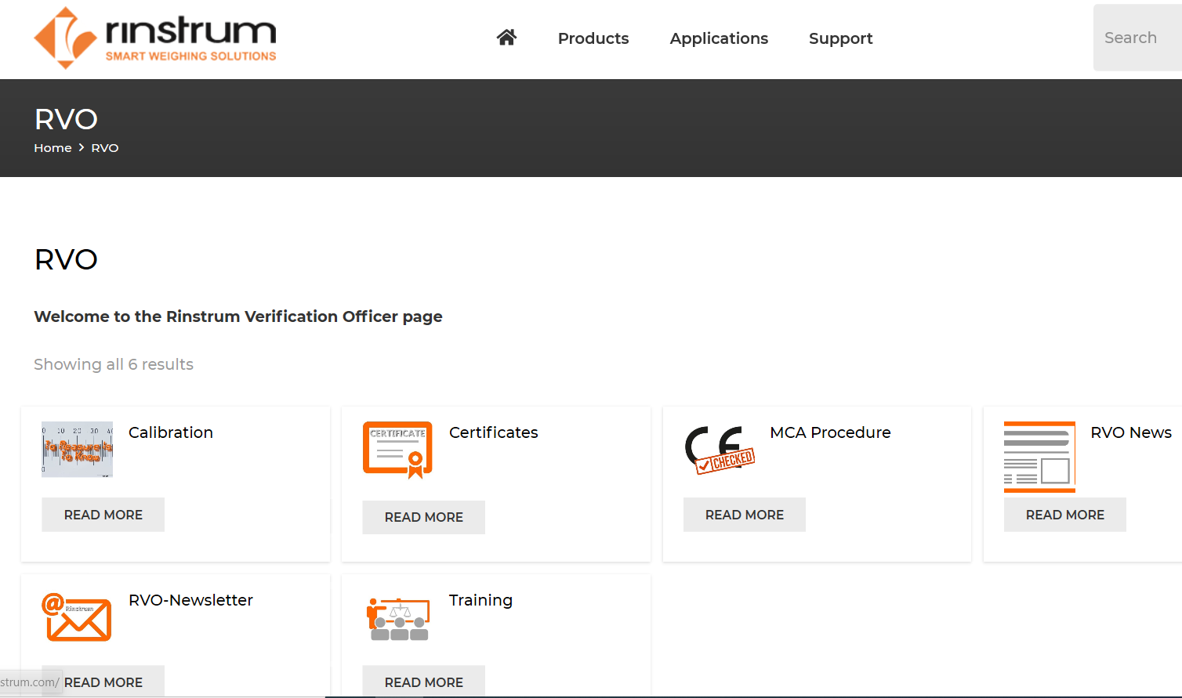
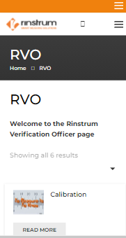
Rinstrum Verification Officers
3.1 RVO Support section
RVO Web Page is accessible through https://rinstrum.com/product-category/rvo/

Slide 56
Rinstrum Verification Officers
3.1 RVO Support section
Certificates
MCA Procedure
RVO News
RVO Newsletter
Training
Calibration
R400 Calibration procedure
R300 Calibration procedure
All related MCA Process Certificates
MCA Process document templates and work instructions.
Latest news including MCA updates and Upcoming events
Monthly Newsletter Archive
Training Material

Slide 57
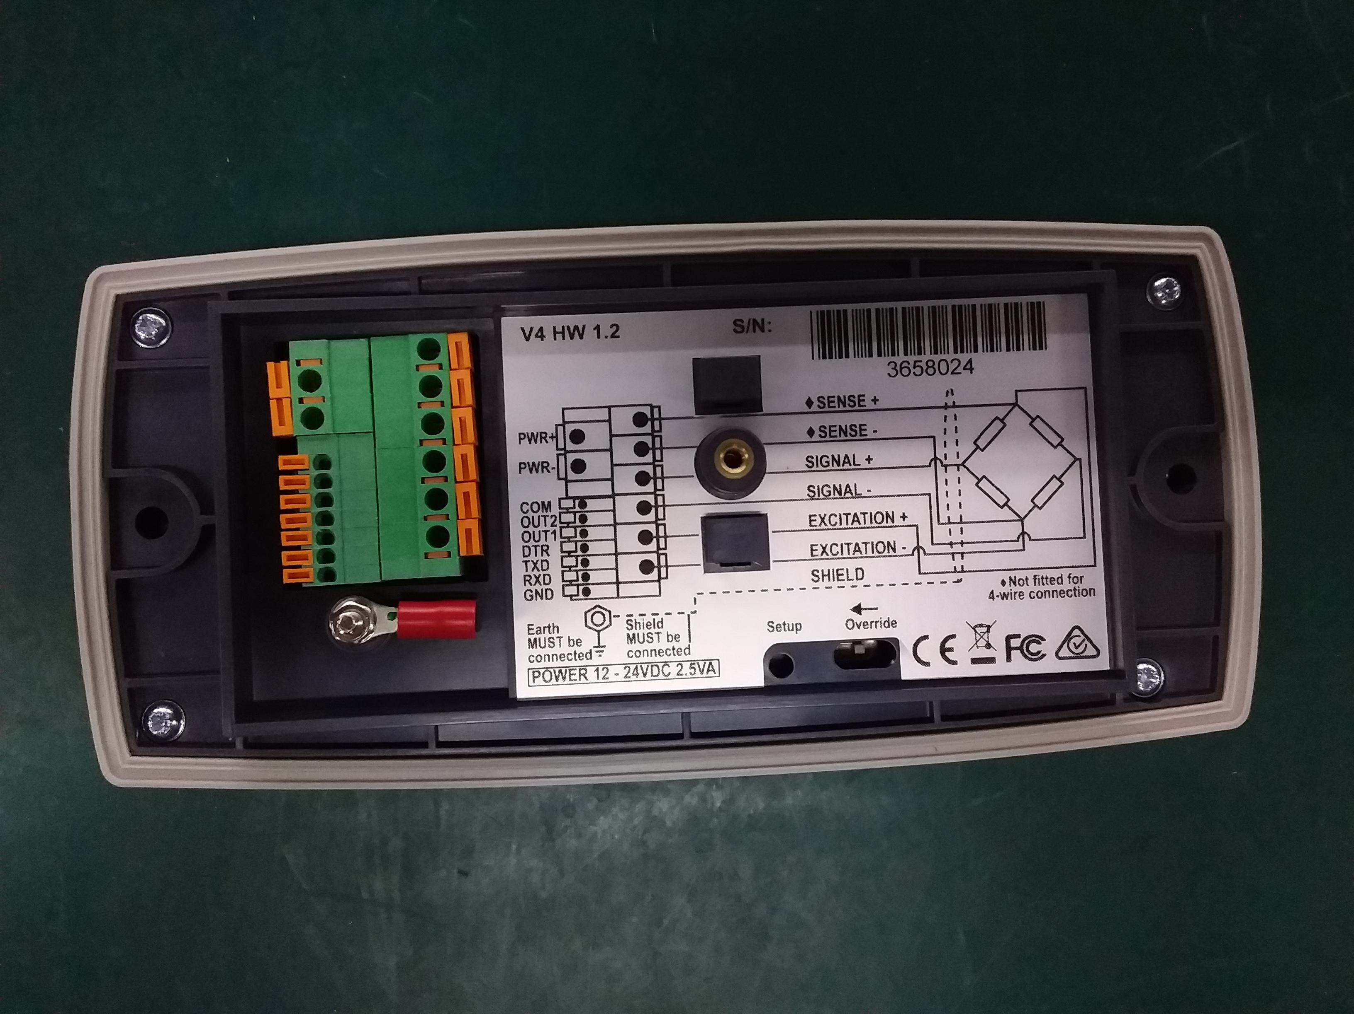
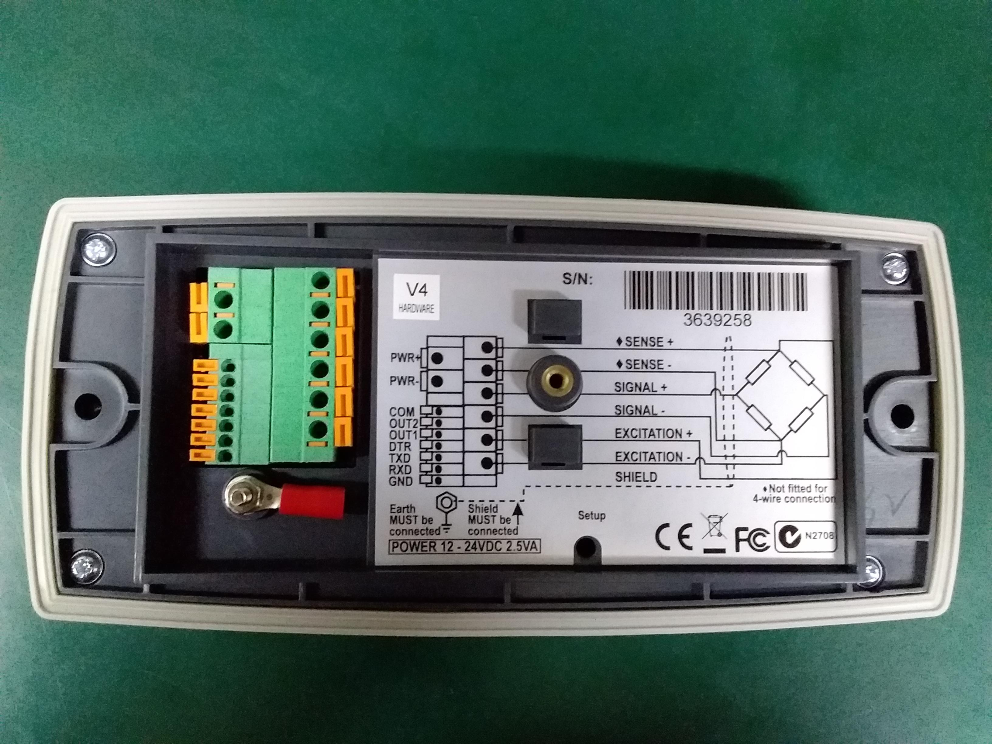
Rinstrum Verification Officers
3.2 Common Mistakes
Incorrect Type Approval Certificate Number
Rinstrum List of certificates
R300 V4 Indicator vs R300 V4 HW1.2 Indicator
 | T Number | TC Number
R300 Series V4 | T6244 | TC6242
R300 V4 HW 1.2 | T11438 | TC11437
X300 Series | T7418 | TC6821
R400 Series | T6822 | TC6821
C500 Series | T11766 | TC11766

Slide 58
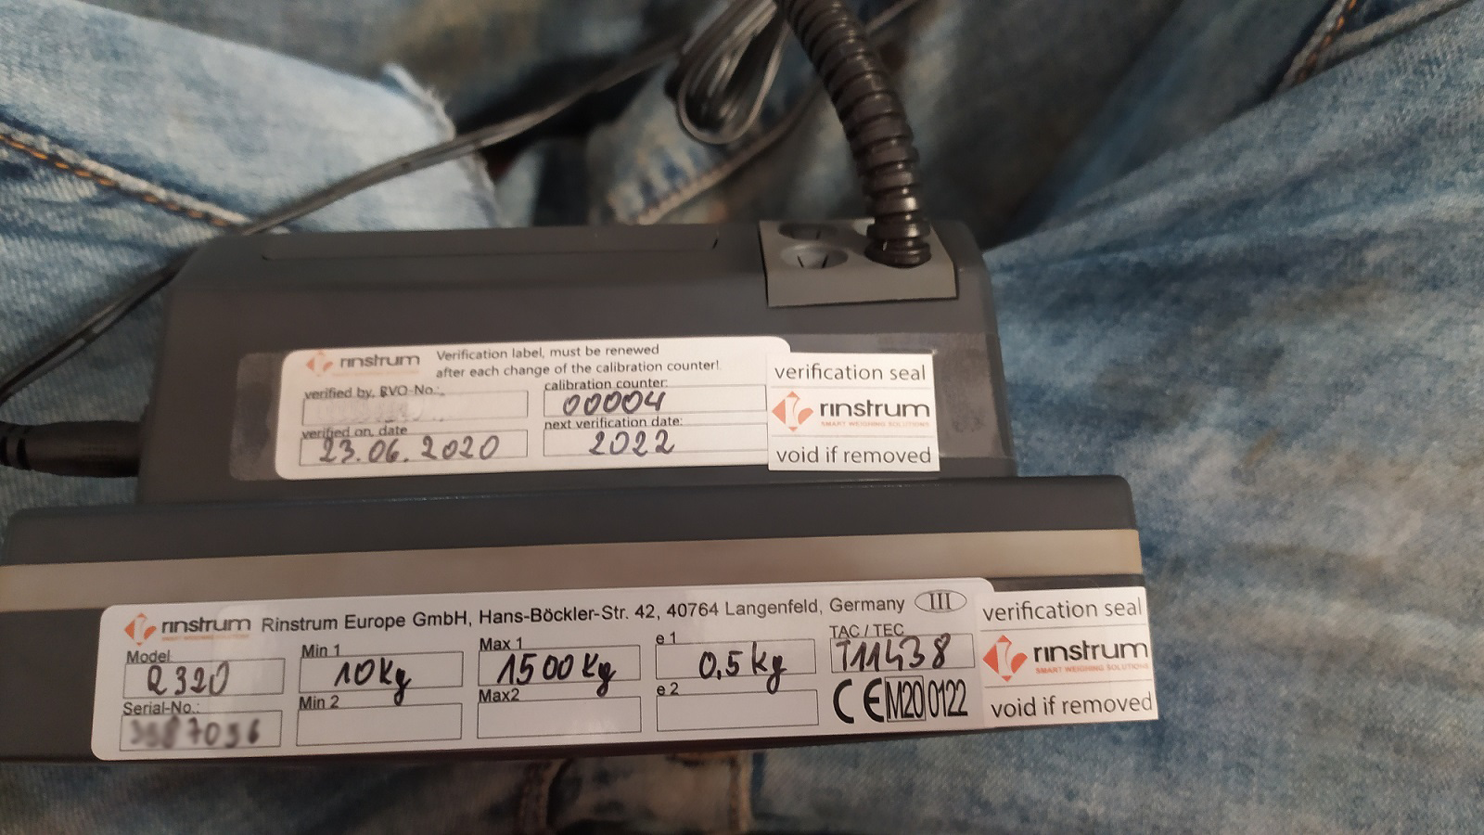
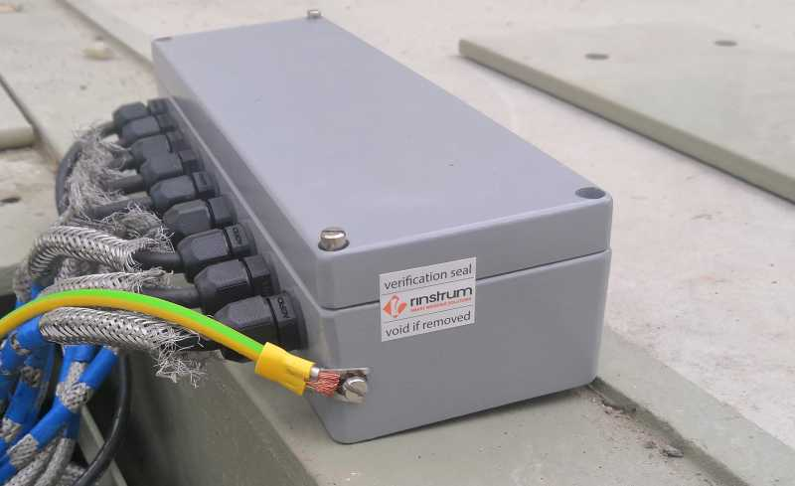
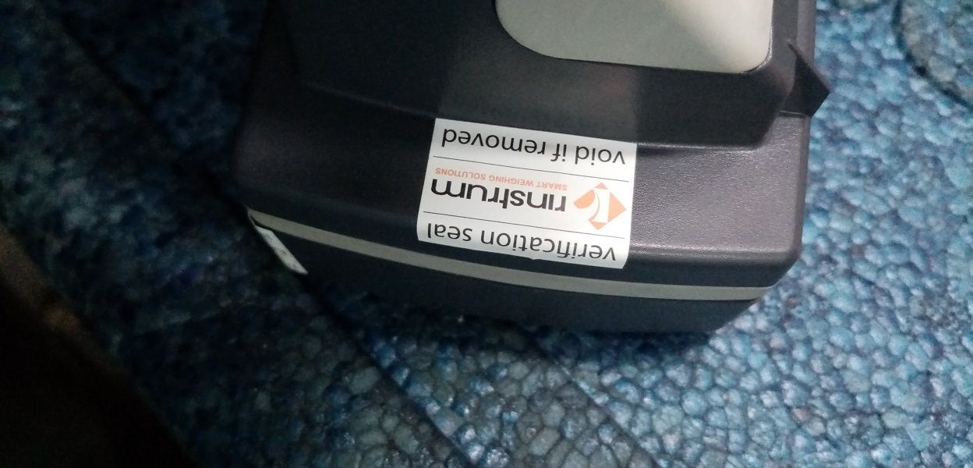
Rinstrum Verification Officers
3.2 Common Mistakes
Imperfect Sealing
Make sure to seal in a way that Scale can not be
Modified without removing the void stickers.
Send all images with the MCA file.

Slide 59
Rinstrum Updates
4.1 UKCA Approvals
Rinstrum has applied for UKCA approvals and currently under processing.
RVOs can apply for a training with Rinstrum for performing MCA with UKCA approvals.
Email us at varification@rinstrum.com for more information.

Slide 60
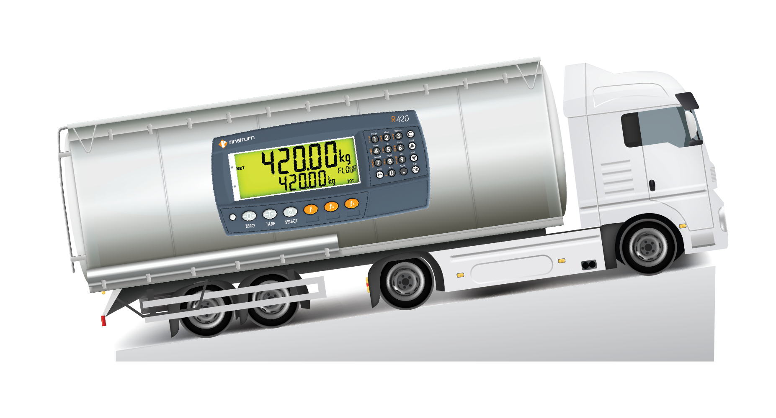
Rinstrum Updates
4.1 Rinstrum Onboard Weighing Approval

Slide 61
Rinstrum Updates
4.1 Rinstrum Onboard Weighing Approval

Slide 62
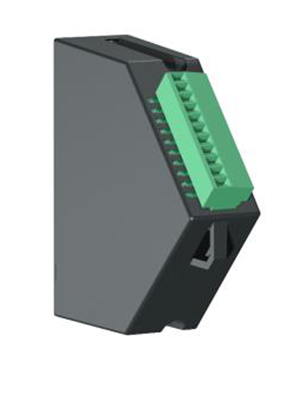
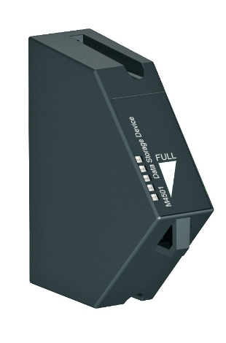
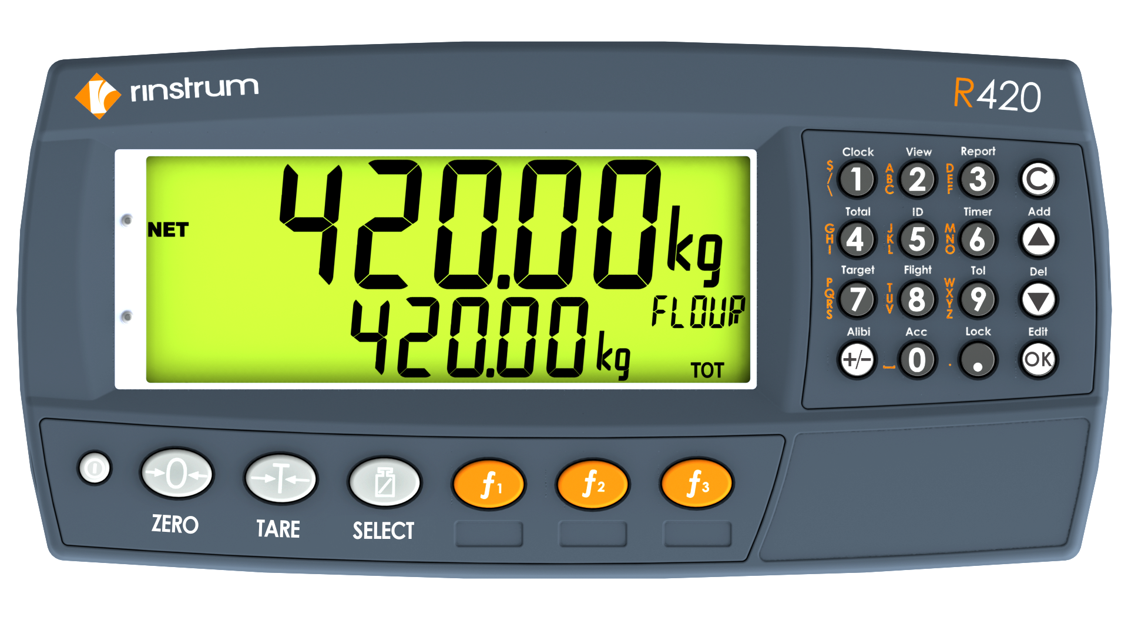
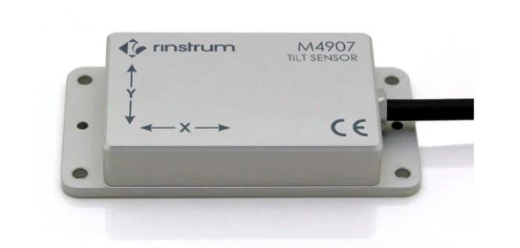
Rinstrum Updates
4.1 Rinstrum Onboard Weighing Approval
M4501
Data Storage Module
R420 Indicator
M4907
Tilt Sensor Module
M4211
Tilt Compensation module

Slide 63
Conclusion
Conclusion
This training is focused on refreshing the knowledge of the RVO to perform successful MCA.
Training includes an online test.
Renew of RVO commitment (X00A-812).
RVO certificate

Slide 64
X00A-837-201

